Slide 1
INTRODUCTION TO IMMUNOLOGY
Immunology
Definition: The study of the physiologic mechanisms that allow the body to recognize materials as foreign or abnormal and to neutralize or eliminate those foreign materials.
Immunology, branch of medicine/microbiology that studies the responses to foreign bodies, e.g. fungi, viruses, bacteria and bacterial toxins
Immunology– Study of the components and function of the immune system

Slide 2
What is immunity?
Refers to “Protection” from infection, tumors, etc.
Innate immunity is always available
Adaptive immunity distinguishes “self” from “non-self” and involves immune system “education”
Responses that may result in host tissue damage.
HENCE: Immunity is the body's ability to fight off harmful micro-organisms –PATHOGENS- that invade it.

Slide 3
Antigen
A substance (antigen) that is capable of reacting with the products of a specific immune response, e.g., antibody or specific sensitized T-lymphocytes.
A “self” component may be considered an antigen even though one does not generally make immune responses against those components

Slide 4
Immune System
Comprises of Molecules, cells, tissues and organs which provide nonspecific and specific protection against: Microorganisms, Microbial toxins and Tumor cells
Tissues and organs of the immune system, are specialized cells, and the influence of genetic, nutritional and other factors on the immune system.
Immune therapy that are effective against Ab deficiencies and autoimmune diseases

Slide 5
THE IMMUNE RESPONSE AND IMMUNITY
Immune response maybe:
- Innate (non-specific)
-Adaptive (specific)
Acquisition of Immunity may be:
Natural or Artificial

Slide 6
NATURALLY ACQUIRED IMMUNITY
This may be
Active where Antigens enter body naturally with response of both Innate and adaptive immune systems
It provides long term protection
Passive where Antibodies pass from mother to Fetus across placenta or Infant in breast milk
Provides immediate short term protection

Slide 7
ARTIFICIALLY ACQUIRED IMMUNITY
This may be
Active where antigens enter body through vaccination with response of Innate and adaptive immune systems
It provides long term protection
Passive, where antibodies from immune individuals injected into body. These are Referred to as
- Immune serum globulins (ISG)
-Immune globulins (IG)
-Gamma globulins
Provides immediate short term protection

Slide 8
PRINCIPAL FUNCTION OF THE IMMUNE SYSTEM
To protect humans from pathogenic microorganisms
Pathogenic microorganisms (Pathogens) are microorganisms capable of causing infection and/or disease
Infection. This is the ability of pathogen to enter host, multiply and stimulate an immune response
Disease. Clinical manifestations associated with infection
General principles/characteristic of the immune system
Recognition of self-versus non-self
Selectivity and specificity—The immune system is highly selective and specific for each pathogen 1 pathogen=1 response.
Memory—Once having met a pathogen, the immune system never forgets it.
If you are re-challenged with the same pathogen the memory response will recognize it immediately-and destroy it or neutralize it.

Slide 9
IMMUNE SYSTEMS
The immune system consists: Innate and Acquired immunity, and evolved to become more specific, complex, efficient and regulated.
Two types of immunity
1. Innate immunity (not antigen-specific). This comprises of:
(a) Anatomical barrier
intact skin mucous membrane barrier
sneezing and coughing
cilia

Slide 10
(b) Chemical barriers:
tears
acid (pH)
saliva
bile
(c) Phagocytosis performed by phagocytic cells mainly, neutrophils, Macrophages and dendritic cells:
These engulf and kill invading organisms

Slide 11
2. Adaptive immunity (specific)
This is mediated by Lymphocytes (T and B lymphocytes)
Qn explain the components of innate immunity

Slide 12
Organs of the Immune System
Lymphoid Organs
1. Primary or central lymphoid organs
These are bone marrow and thymus
It’s where lymphocytes are generated
2. Secondary or peripheral lymphoid organs. These are the spleen and lymph nodes
It’s where adaptive immune responses are initiated

Slide 13
1. Bone marrow- where all the immune cells are initially derived.
Through haematopoeisis, stem cells differentiate into either mature cells of the immune system or precursors of cells that migrate and mature elsewhere.
B/marrow produces B cells, NK cells, granulocytes and immature thymocytes in addition to red blood cells and platelets.
2. Thymus:
produces mature T lymphocytes
Immature thymocytes (prothymocytes) , mature here , a process known as ‘thymic education.’
T cells likely to evoke a detrimental autoimmune response are eliminated.
Mature T cells are released into the blood stream.
.

Slide 14
3. Spleen ( an immunological filter for blood)
Made up of B cells, T cells, macrophages, dendritic cells, NK cells and rbcs
Captures foreign materials (Ags).
Immune response is initiated here when macrophages and dendritic cells present Ags to the appropriate B or T cells
Activated B cells produce large amounts of Abs.
Old rbcs are also destroyed in the spleen

Slide 15
4. Lymph nodes: An immunological filter for lymph.
Found throughout the body.
Composed of T cells, B cells, dendritic cells and macrophages.
Drain fluids from most of the body tissues.
Ags are filtered out of the lymph before returning it to circulation.
Immune response is also initiated here.

Slide 16
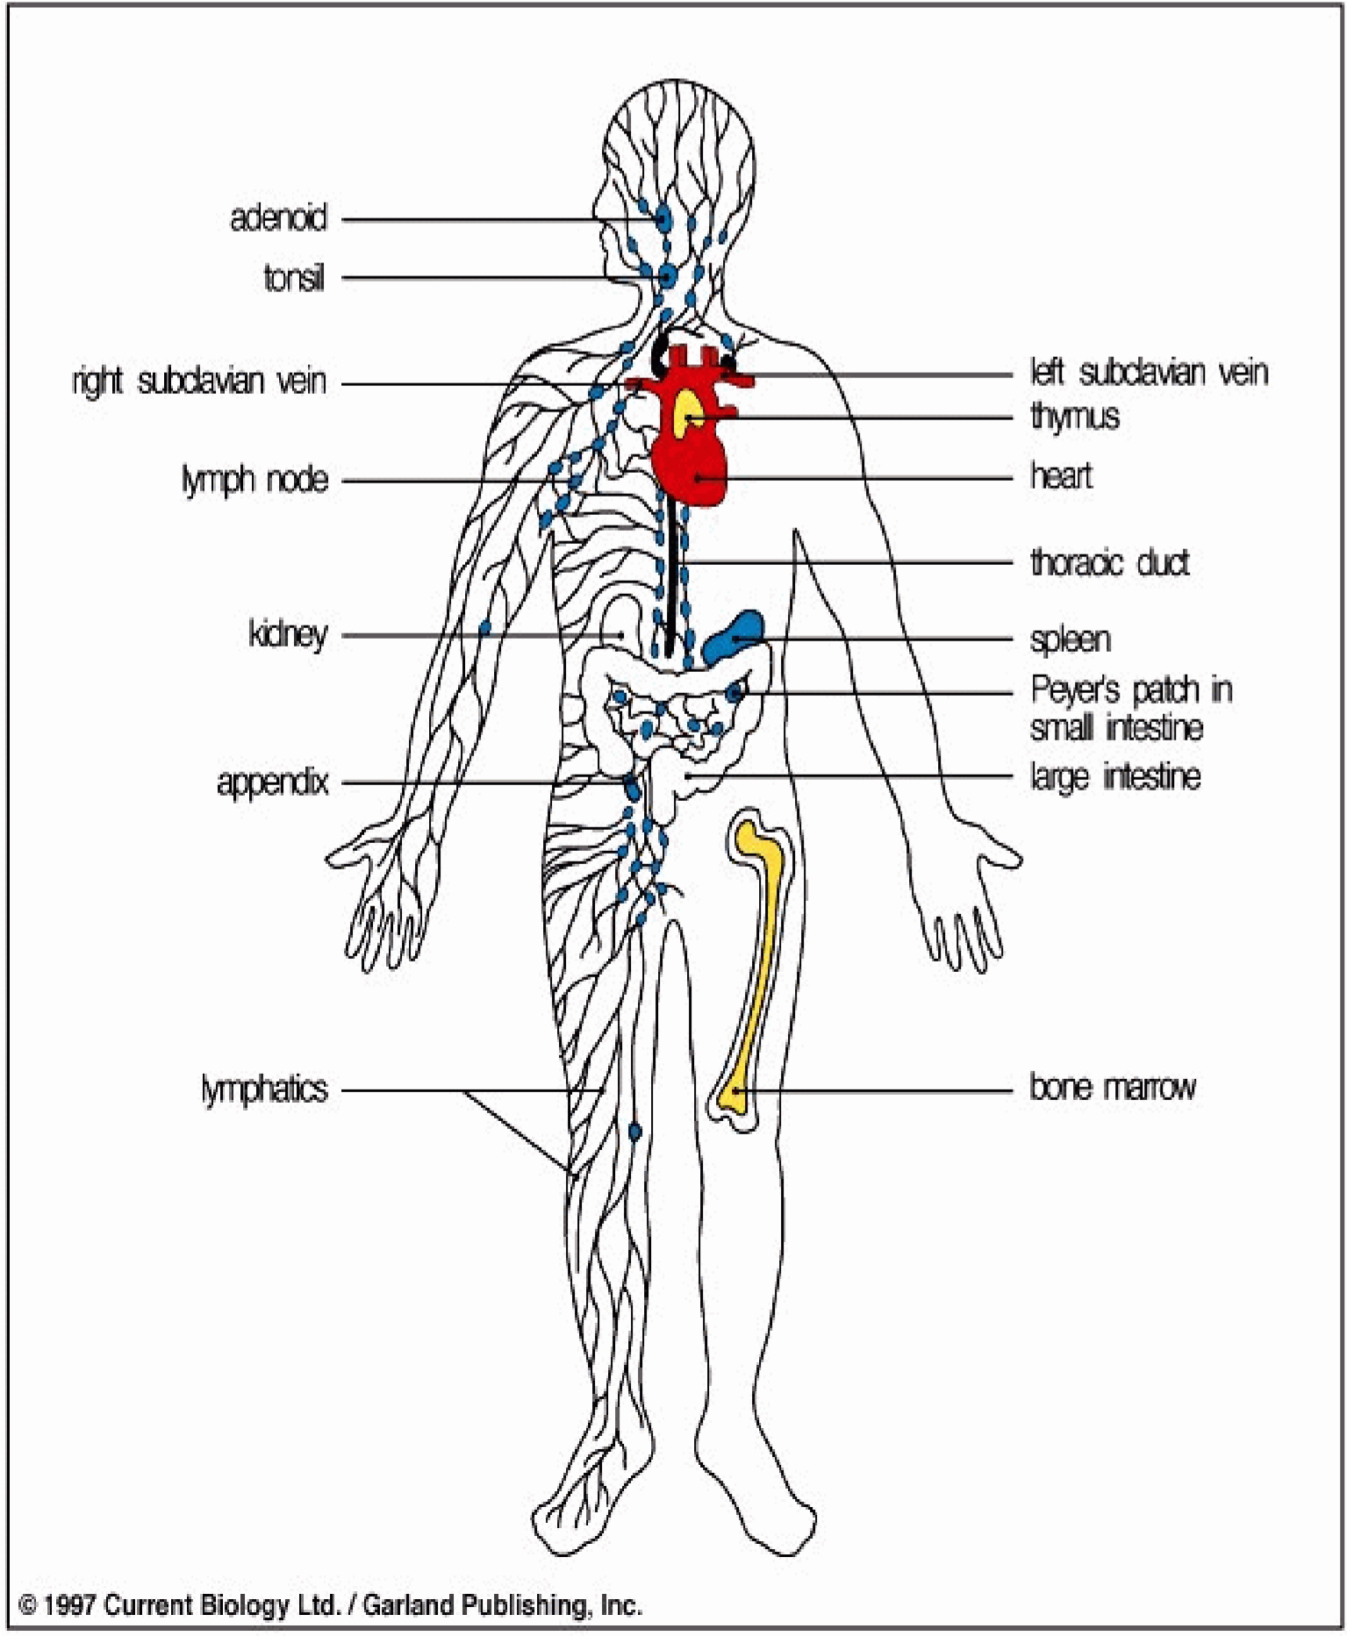
Distribution of Lymphoid Tissues

Slide 17
Cells of immune system
The cells of the immune system or RES (renticuloendpthelial system) provide natural immunity against microorganisms by:
Process of phagocytosis and intracellular killing.
Recruiting other inflammatory cells through the production of cytokines
Presenting peptide antigens to lymphocytes for the production of antigen-specific immunity.

Slide 18
(A)The cells of the immune system or RES (renticuloendpthelial system)
These include:
1. Circulating monocytes ,
2. Resident macrophages in the liver, spleen, lymph nodes, thymus, sub mucosal tissues of the respiratory and alimentary tracts, bone marrow, and connective tissues,
3. And Macrophage-like cells including dendritic cells in lymph nodes, Langerhans cells in skin and glial cells in the central nervous system

Slide 19
(B)T cells :
These are of 2 major subsets that are functionally and phenotypically different.
CD4 T cell/T helper subset is a pertinent coordinator of immune regulation.
CD8 T cell or T killer/suppressor subset, directly kill certain tumor cells, viral-infected cells and sometimes virus.
CD8 T cell is an important down-regulator of the immune response.
Both types of T cells are found throughout the body (lymph nodes, spleen, liver, lung, blood, intestinal and reproductive tracts.

Slide 20
3. Natural Killer (NK) cells
Similar to CD8 T cells.
Effector cells that directly kill certain tumor cells such as melanomas, lymphomas and viral infected cells, most notably herpes and cytomegalovirusinfected cells.
Kill targets without activation in the lymphoid organs.
CD4 T cell activated NK cell readily kills tumor or viral-infected cells more effectively.

Slide 21
:
(C) B cells
Major function is antibody production
(D) Granulocytes or Polymorphonuclear (PMN) Leucocytes:
Composed of 3 cells: neutrophils,eosinophils and basophils.
Functions: removal of bacteria and parasites from the body
(E) Macrophages:
Regulate immune responses.
Scavengers/antigen- presenting cells (APC).
Stimulated macrophages exhibit increased levels of phagocytosis and are also secretory.

Slide 22
(F) Dendritic cells:
Antigen – presenting cells (APC).
More efficient APCs than macrophages
Found in the structural compartments of the lymphoid organs such as the thymus, lymph nodes and spleen; also in blood stream.
Capture Ag and take to the lymphoid organs where immune response is initiated.
However, they are difficult to isolate.
Recent finding shows that dendritic cells bind high amount of HIV, and may be a reservoir of virus that is transmitted to CD4 T cells during an activation event.

Slide 23
ORIGIN OF IMMUNE CELLS
Derived from common progenitor cell in bone marrow
  Pluripotent hematopoietic stem cell
Progenitor Stem Cells
  Erythroid lineage
Erythrocytes and Megakaryocytes – Myeloid lineage
Monocyte/macrophage, dendritic cells, PMN’s, mast cells – Lymphoid lineage
Small and large lymphocytes

